Slide 1

The Smart Coffee Shop System

Slide 2
Introduction
The coffee shop industry has become increasingly competitive, with customers expecting high convenience and personalization. Digital solutions are essential to meet these demands.
This project outlines the development of a Coffee Shop Platform that enables shop owners to:
Create an online presence
Allow customers to browse menus
Place orders and make payments
Track orders in real-time
Provide an administrative panel for shop management, including inventory, sales tracking, and customer management.

Slide 3
Project Organization
01
02
03
Ram Prashad Das Kanto
Durjoy Das
Ahammed Reza Rahim
Developed backend API using Laravel, coordinated project timeline, and implemented security measures.
Built responsive frontend pages using JavaScript and CSS, ensured design consistency, and optimized performance.
Designed UI wireframes and mockups, conducted user research, led usability testing, and worked on the seat selection process.

Slide 4

Hardware and Software Requirements
Hardware
PCs for development
Cloud or physical server for hosting
Software
Backend: Laravel(PHP 7.4+)
Frontend: JavaScript, HTML, CSS
Database: XAMPP(Apache, MySQL)
Tools: Composer, Git

Slide 5
System Architecture
Frontend
Backend
Administrative Panel
User Interface built with JavaScript and CSS.
Laravel API connecting to the database.
For shop management.

Slide 6
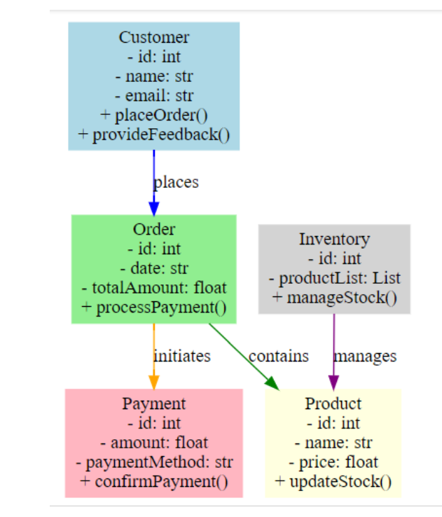
Class Diagram of the System

Slide 7
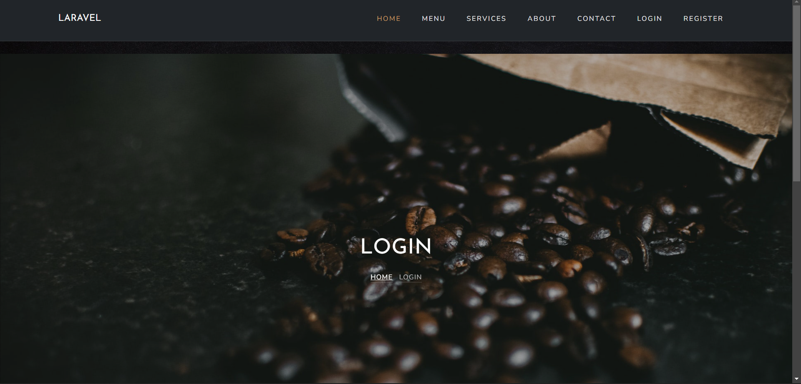
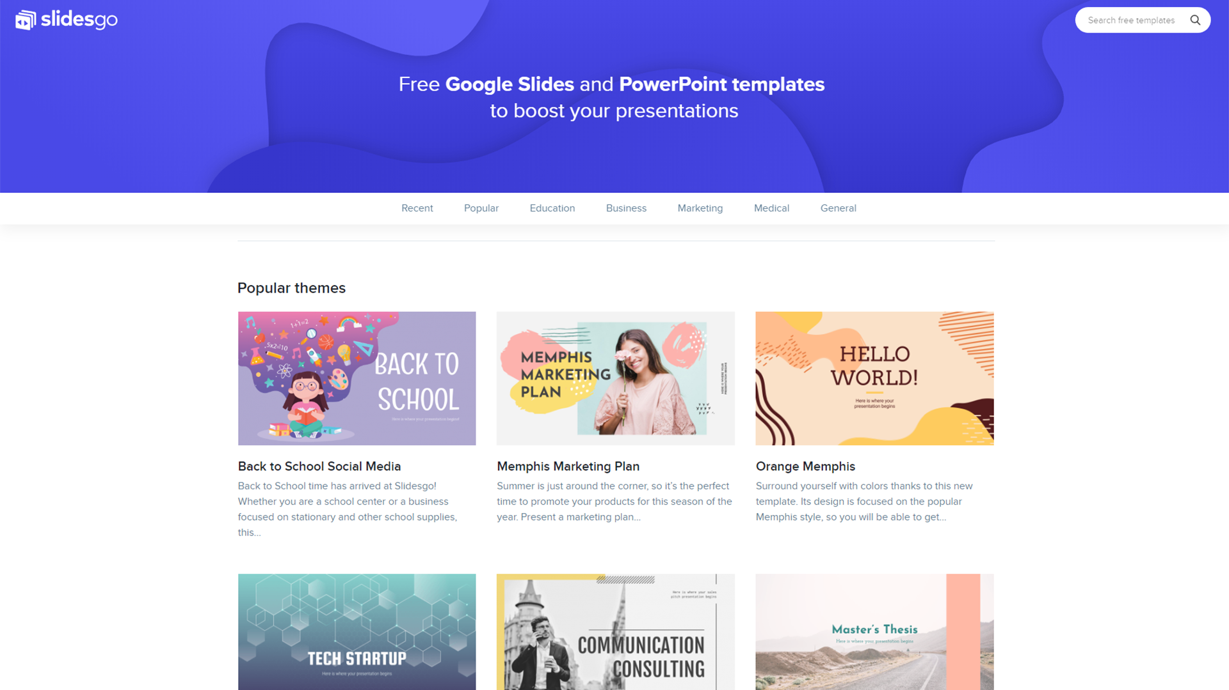
Project Demonstration

Slide 8
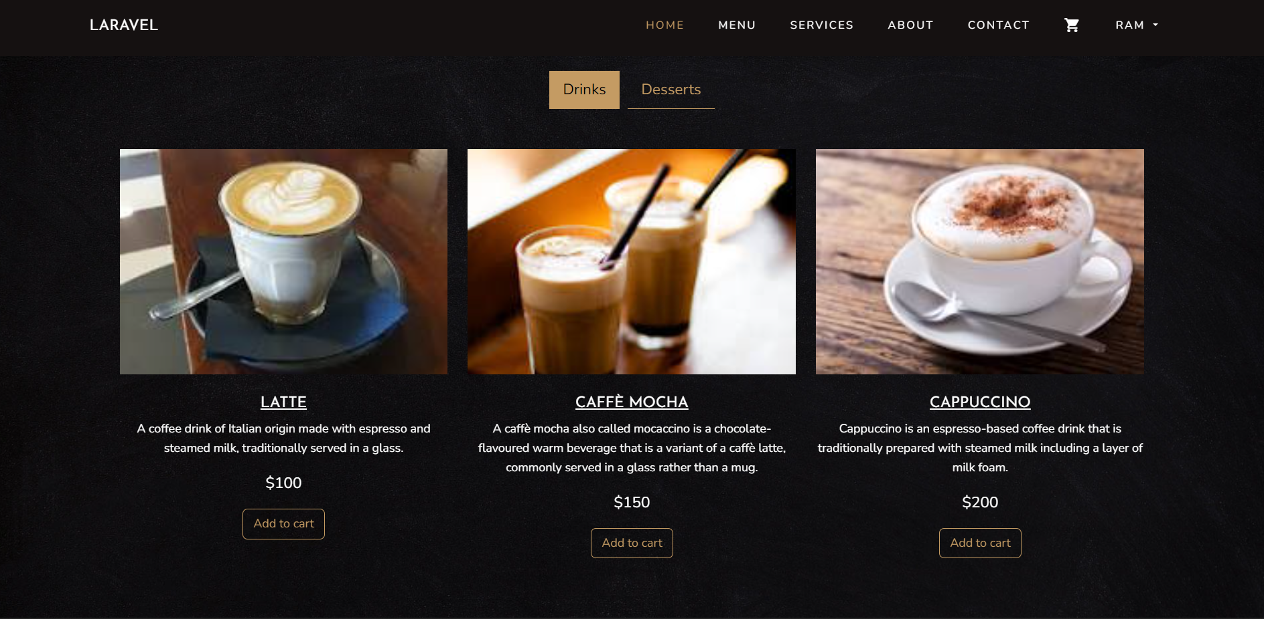
Project Demonstration

Slide 9
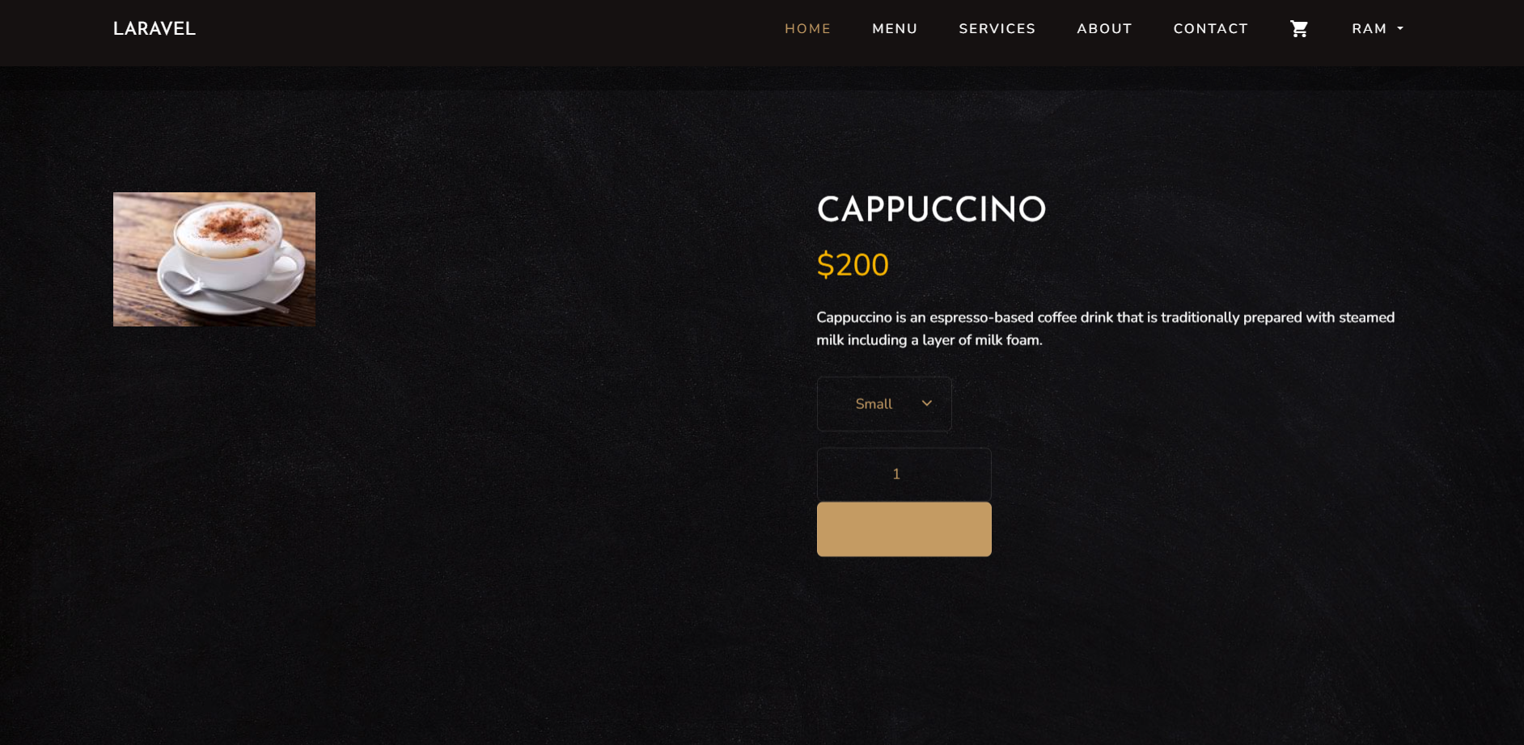
Project Demonstration

Slide 10
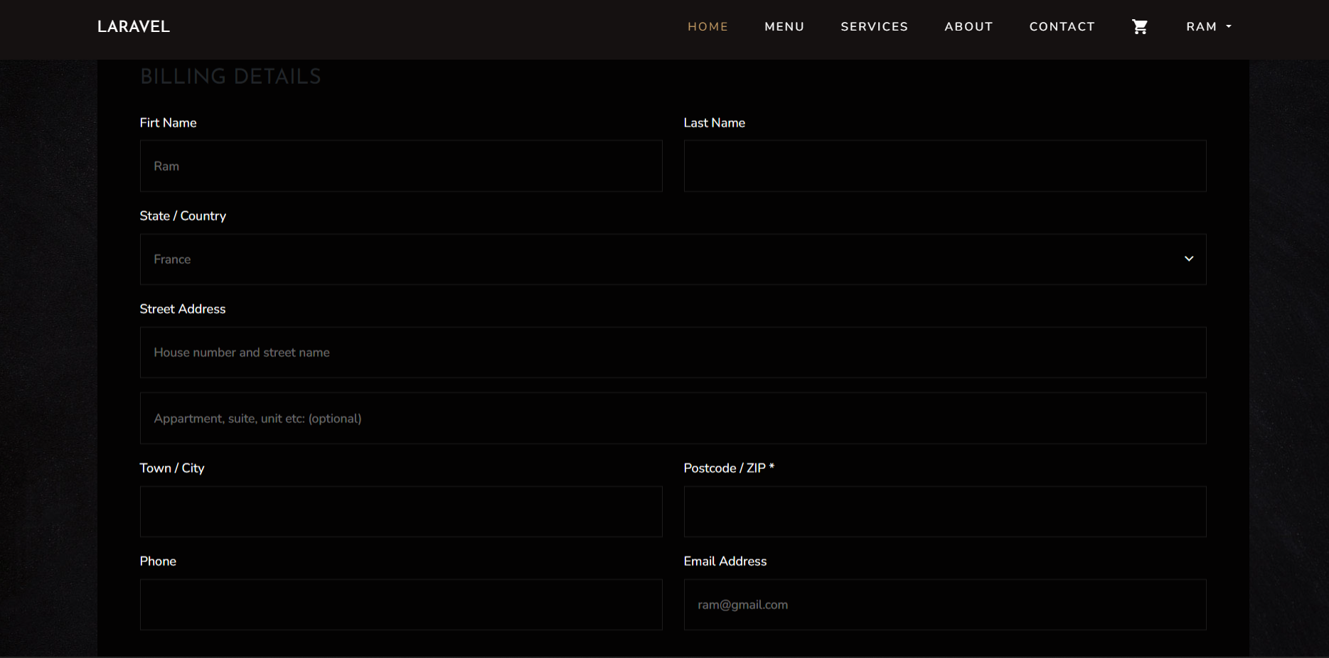
Project Demonstration

Slide 11
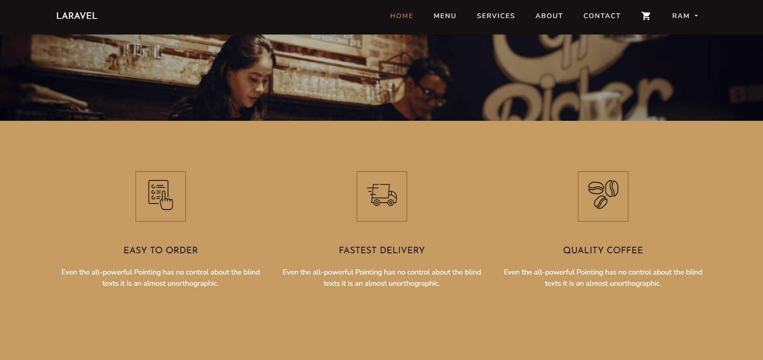
Project Demonstration

Slide 12
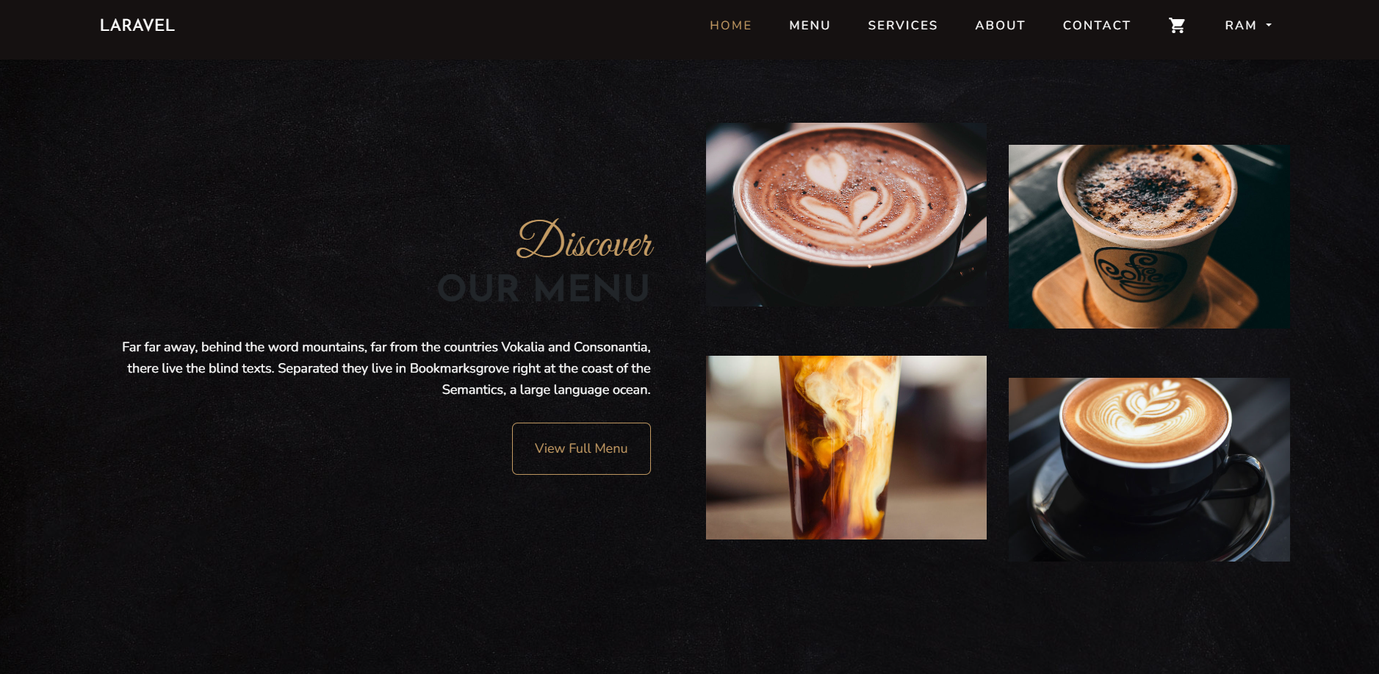
Project Demonstration

Slide 13
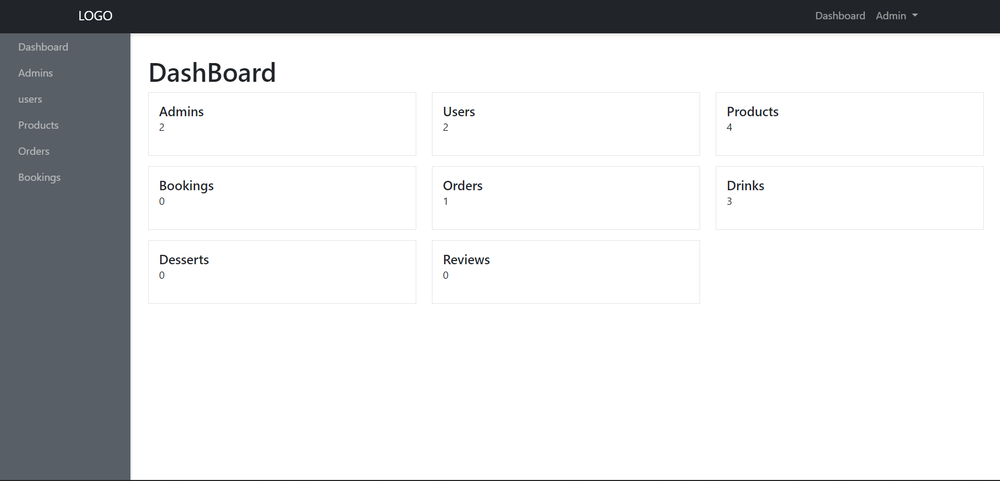
Project Demonstration

Slide 14
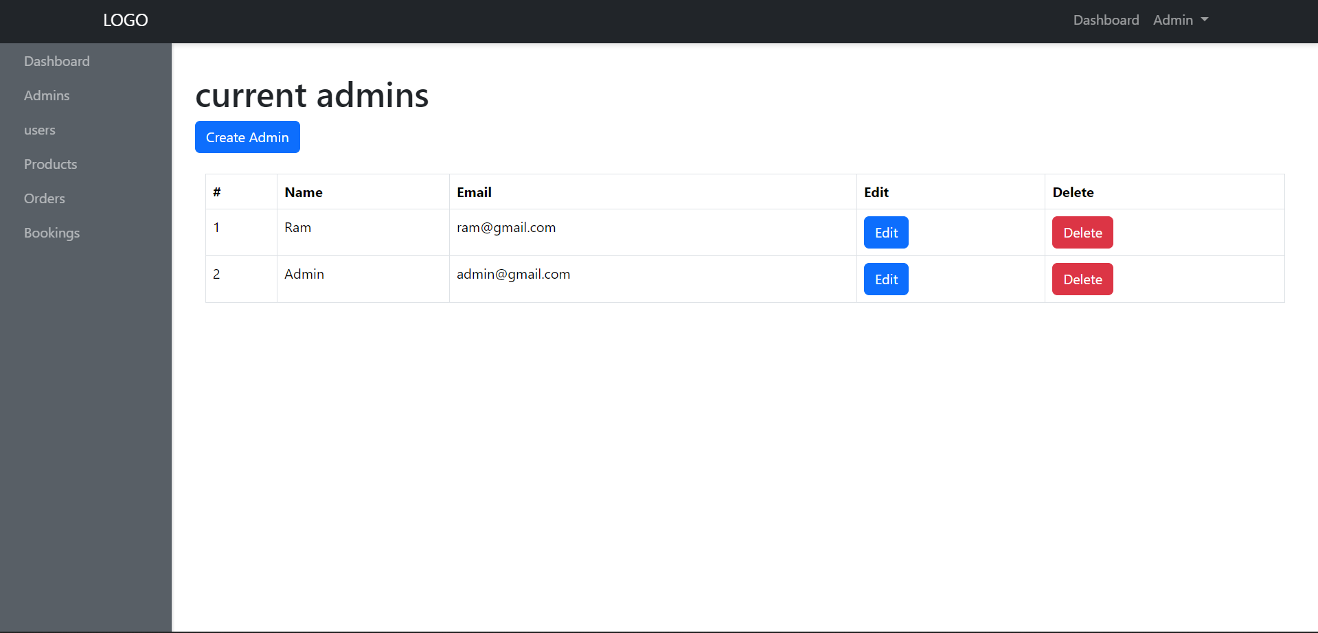
Project Demonstration

Slide 15
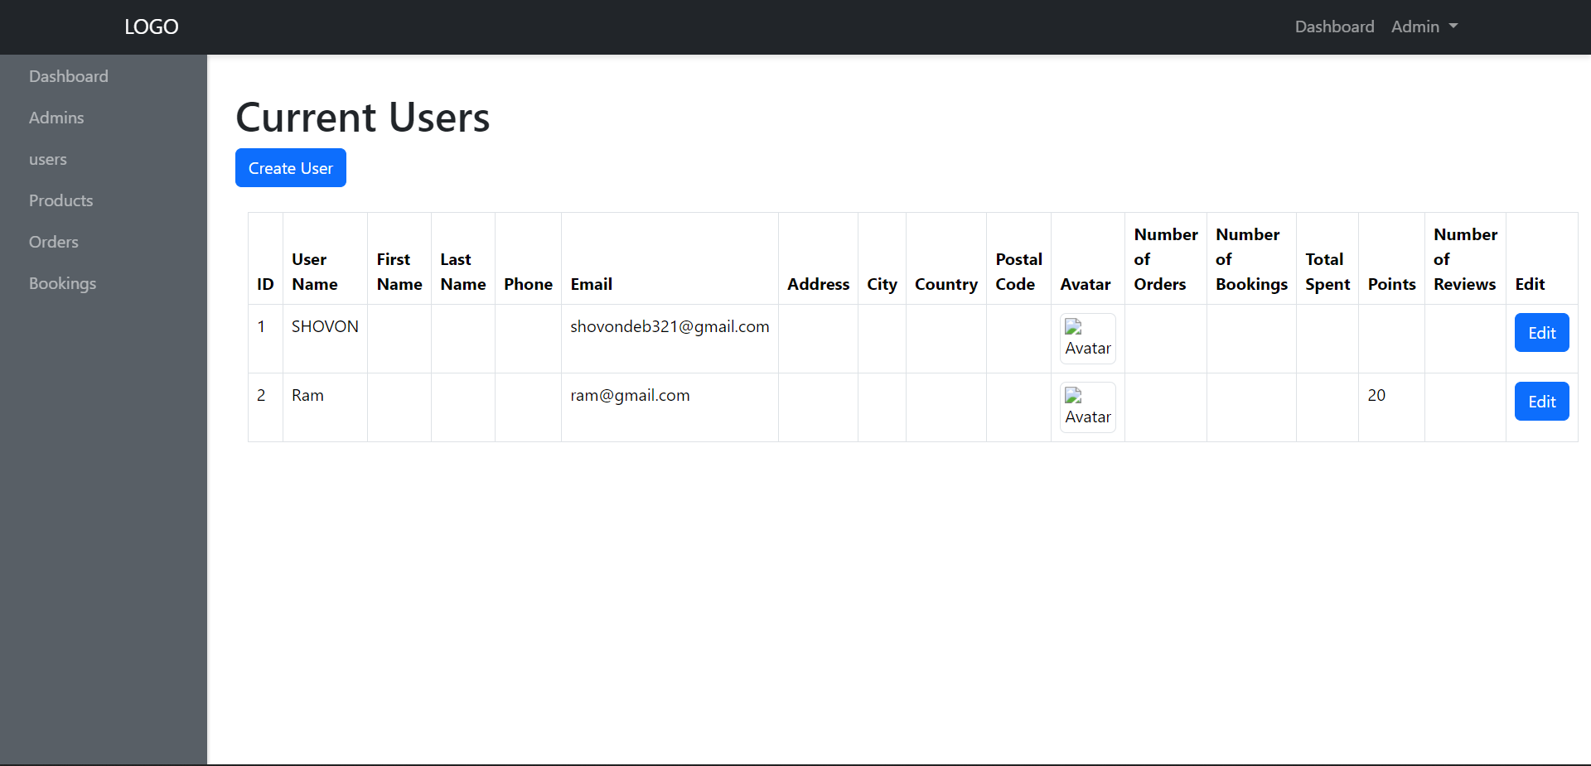
Project Demonstration

Slide 16
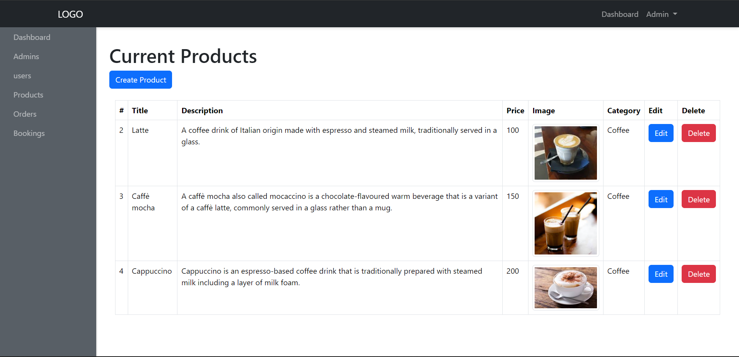
Project Demonstration

Slide 17
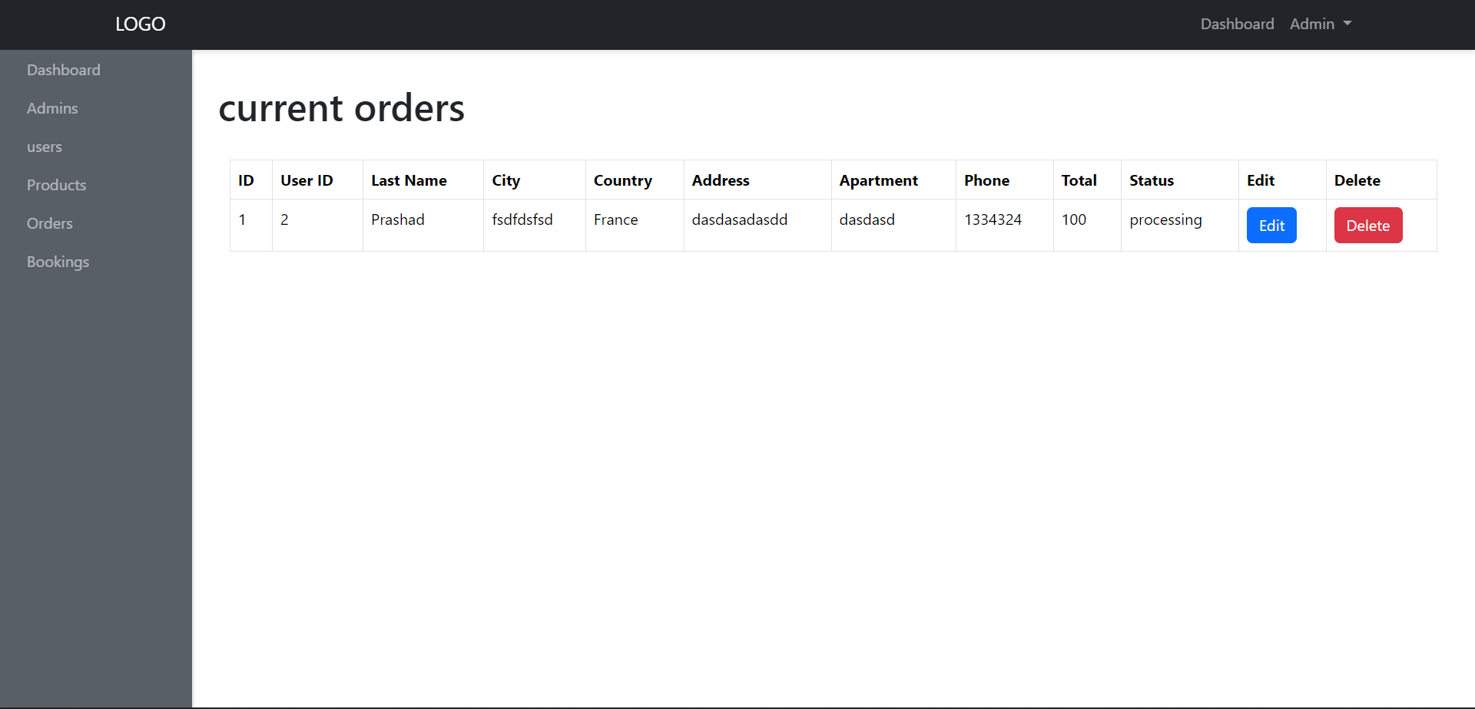
Project Demonstration

Slide 18
Testing
Unit Testing:
Ensure individual components function correctly.
Integration Testing:
Verify interactions between different components.
User Acceptance Testing (UAT):
Gather feedback from real users to validate functionality and usability.

Slide 19

Limitations
Challenges Faced:
Technical limitations, including integration issues with the payment gateway.
Time constraints during the development process impacted feature implementation.
Limited user feedback during the testing phases led to some usability challenges.

Slide 20

Conclusion
The Coffee Shop Platform provides a robust solution for coffee shop owners to meet modern consumer demands.
By enhancing operational efficiency and customer engagement, the platform drives profitability in an increasingly competitive market.

Slide 21
Thank You

